Slide 1
Computer System Architecture
Unit-1

Slide 2
REGISTER TRANSFER LANGUAGE
A micro operations is an elementary operation performed on the information stored in one or more registers.
The result of the operation may replace the previous binary information of a register or may by transferred to another register.
The symbolic notation used to describe the micro operation transfer among registers is called a register transfer language.
The term “register transfer” implies the availability of hardware logic circuits that can perform stated micro operation and transfer the results to the operation to the same or another register.
For any function of the computer, the register transfer language can be used to describe the (sequence of) microoperations.

Slide 3
DESIGNATION OF REGISTERS
Registers are designated by capital letters, sometimes followed by numbers (e.g., A, R13, IR)
Often the names indicate function:
MAR - memory address register
PC - program counter
IR - instruction register
Registers and their contents can be viewed and represented in various ways
A register can be viewed as a single entity:
Registers may also be represented showing the bits of data they contain
MAR

Slide 4
DESIGNATION OF REGISTERS
Notations and conventions:
If we intend to copy only a portion of data it is important to specify precisely where the data is located within the storage.
R : High Low
R1
7 6 5 4 3 2 1 0
(a) Complete Register R1
(b) Individual bits within R, such as R(0-7), R(15), R(L)
15 0
15 8 7 0
R2
PC (H) PC (L)
(c) Numbering of bits in R2
(d) PC register divided into a High and a Low part

Slide 5
REGISTER TRANSFER
Register Transfer
Copying the contents of one register to another is a register transfer
A register transfer is indicated as
R2 ← R1
In this case the contents of register R1 are copied (loaded) into register R2
A simultaneous transfer of all bits from the source R1 to the destination register R2, during one clock pulse
Note that this is a non-destructive; i.e. the contents of R1 are not altered by copying (loading) them to R2

Slide 6
REGISTER TRANSFER
Register Transfer
A register transfer such as
R3 ← R5
Implies that the digital system has
the data lines from the source register (R5) to the destination register (R3)
Parallel load in the destination register (R3)
Control lines to perform the action

Slide 7
CONTROL FUNCTIONS
Register Transfer
Often actions need to only occur if a certain condition is true
This is similar to an “if” statement in a programming language
In digital systems, this is often done via a control signal, called a control function
If the signal is 1, the action takes place
This is represented as:
P: R2 ← R1
Which means “if P = 1, then load the contents of register R1 into register R2”, i.e., if (P = 1) then (R2 ← R1)

Slide 8
HARDWARE IMPLEMENTATION OF CONTROLLED TRANSFERS
Register Transfer
Implementation of controlled transfer
P: R2 ← R1
Block diagram
Control
Circuit
P
Load
R2
Clock
n
R1
Timing diagram
t
t+1
Clock
Load
Transfer occurs here
The same clock controls the circuits that generate the control function
and the destination register
Registers are assumed to use positive-edge-triggered flip-flops

Slide 9
SIMULTANEOUS OPERATIONS
Register Transfer
If two or more operations are to occur simultaneously, they are separated with commas
P: R3 ← R5, MAR ← IR
Here, if the control function P = 1, load the contents of R5 into R3, and at the same time (clock), load the contents of register IR into register MAR

Slide 10
BASIC SYMBOLS FOR REGISTER TRANSFERS
Register Transfer
Symbols
Description Examples
Capital letters Denotes a register MAR, R2
& numerals
Parentheses () Denotes a part of a register R2(0-7), R2(L)
Arrow ← Denotes transfer of information R2 ← R1
Colon : Denotes termination of control function P:
Comma , Separates two micro-operations A ← B, B ← A

Slide 11
CONNECTING REGISTRS
Register Transfer
In a digital system with many registers, it is impractical to have data and control lines to directly allow each register to be loaded with the contents of every possible other registers
To completely connect n registers → n(n-1) lines
O(n²) cost
This is not a realistic approach to use in a large digital system
Instead, take a different approach
Have one centralized set of circuits for data transfer – the bus
Have control circuits to select which register is the source, and which is the destination

Slide 12
BUS AND BUS TRANSFER
Bus and Memory Transfers
Bus is a path(of a group of wires) over which information is transferred, from any of several sources to any of several destinations.
From a register to bus: BUS ← R
Register A
Register B
Register C
Register D
Bus lines

Slide 13
Three-State Buffers
3-state bus buffers are often used at the outputs of storage flip-flops.
Essentially, the buffer unit “holds” the value stored in the FF.
Holding is useful for synchronizing enabling of parallel circuits
The buffer unit can be used along with a Decoder unit as a replacement for an address multiplexer.
This is an alternative approach.
Bus line for bit K
R0
R1
R2
R3
{
S0
S1
E
0
1
2
3
Select
Enable
2x4
DEC
(K)

Slide 14
Three-State Buffers
3-state bus buffers are often used at the outputs of storage flip-flops.
Essentially, the buffer unit “holds” the value stored in the FF.
Holding is useful for synchronizing enabling of parallel circuits
The buffer unit can be used along with a Decoder unit as a replacement for an address multiplexer.
This is an alternative approach.
Bus line for bit K
R0
R1
R2
R3
{
S0
S1
E
0
1
2
3
Select
Enable
2x4
DEC
(K)

Slide 15
Three-State Buffers
3-state bus buffers are often used at the outputs of storage flip-flops.
Essentially, the buffer unit “holds” the value stored in the FF.
Holding is useful for synchronizing enabling of parallel circuits
The buffer unit can be used along with a Decoder unit as a replacement for an address multiplexer.
This is an alternative approach.
Bus: R2(K)
R0
R1
R2
R3
0
1
1
{
S0
S1
E
0
1
2
3
Select
Enable
2x4
DEC
(K)

Slide 16
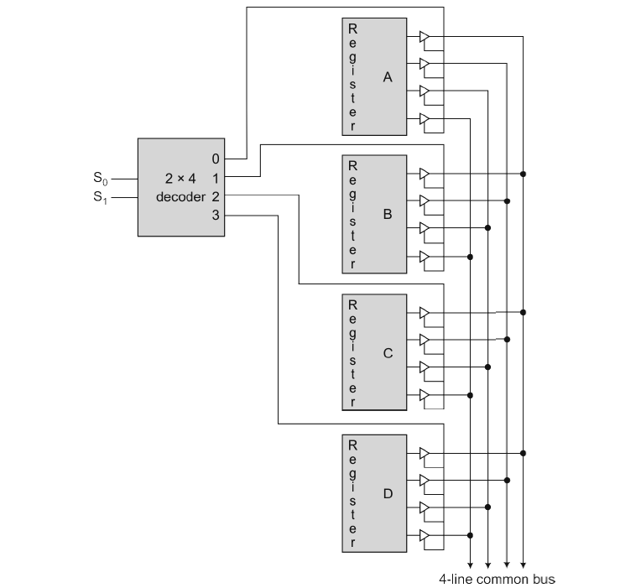
Using Tri-state buffers and the decoder construct a bus system to transfer information from four registers. Each register is 4-bit wide.

Slide 17
BUS TRANSFER IN RTL
Bus and Memory Transfers
Depending on whether the bus is to be mentioned explicitly or not, register transfer can be indicated as either
or
In the former case the bus is implicit, but in the latter, it is explicitly indicated
R2 ← R1
BUS ← R1, R2 ← BUS

Slide 18
MEMORY (RAM)
Bus and Memory Transfers
Memory (RAM) can be thought as a sequential circuits containing some number of registers
These registers hold the words of memory
Each of the r registers is indicated by an address
These addresses range from 0 to r-1
Each register (word) can hold n bits of data
Assume the RAM contains r = 2k words. It needs the following
n data input lines
n data output lines
k address lines
A Read control line
A Write control line
data input lines
n
address lines
k
RAM
unit
Read
Write
n
data output lines

Slide 19
MEMORY TRANSFER
Bus and Memory Transfers
Collectively, the memory is viewed at the register level as a device, M.
Since it contains multiple locations, we must specify which address in memory we will be using
This is done by indexing memory references
Memory is usually accessed in computer systems by putting the desired address in a special register, the Memory Address Register (MAR, or AR)
When memory is accessed, the contents of the MAR get sent to the memory unit’s address lines
M
Memory
unit
Read
AR
Write
Data out
Data in

Slide 20
MEMORY READ
Bus and Memory Transfers
To read a value from a location in memory and load it into a register, the register transfer language notation looks like this:
This causes the following to occur
The contents of the MAR get sent to the memory address lines
A Read (= 1) gets sent to the memory unit
The contents of the specified address are put on the memory’s output data lines
These get sent over the bus to be loaded into register R1
R1 ← M[MAR]

Slide 21
MEMORY WRITE
Bus and Memory Transfers
To write a value from a register to a location in memory looks like this in register transfer language:
This causes the following to occur
The contents of the MAR get sent to the memory address lines
A Write (= 1) gets sent to the memory unit
The values in register R1 get sent over the bus to the data input lines of the memory
The values get loaded into the specified address in the memory
M[MAR] ← R1

Slide 22
SUMMARY OF R. TRANSFER MICROOPERATIONS
Bus and Memory Transfers
A ← B Transfer content of reg. B into reg. A
AR ← DR(AD) Transfer content of AD portion of reg. DR into reg. AR
A ← constant Transfer a binary constant into reg. A
ABUS ← R1, Transfer content of R1 into bus A and, at the same time,
R2 ← ABUS transfer content of bus A into R2
AR Address register
DR Data register
M[R] Memory word specified by reg. R
M Equivalent to M[AR]
DR ← M Memory read operation: transfers content of
memory word specified by AR into DR
M ← DR Memory write operation: transfers content of
DR into memory word specified by AR

Slide 23
MICROOPERATIONS
Arithmetic Microoperations
Computer system microoperations are of four types:
- Register transfer microoperations
- Arithmetic microoperations
- Logic microoperations
- Shift microoperations

Slide 24
ARITHMETIC MICROOPERATIONS
Arithmetic Microoperations
The basic arithmetic microoperations are
Addition
Subtraction
Increment
Decrement
The additional arithmetic microoperations are
Add with carry
Subtract with borrow
Transfer/Load
etc. …
Summary of Typical Arithmetic Micro-Operations
R3 ← R1 + R2 Contents of R1 plus R2 transferred to R3
R3 ← R1 - R2 Contents of R1 minus R2 transferred to R3
R2 ← R2’ Complement the contents of R2
R2 ← R2’+ 1 2's complement the contents of R2 (negate)
R3 ← R1 + R2’+ 1 subtraction
R1 ← R1 + 1 Increment
R1 ← R1 – 1 Decrement

Slide 25
BINARY ADDER
A binary adder is a digital circuit that produces the arithmetic sum of two binary numbers.
A binary adder can be constructed with full adders connected in cascade with the output carry form each full adder connected to the input carry of the next full adder in the chain.
The four-bit adder is a typical example of a standard component .It can be used in many application involving arithmetic operations.
The input carry to the adder is C0and it ripples through the full adders to the output carry C4 .
n-bit binary adder requires n full adders.

Slide 26
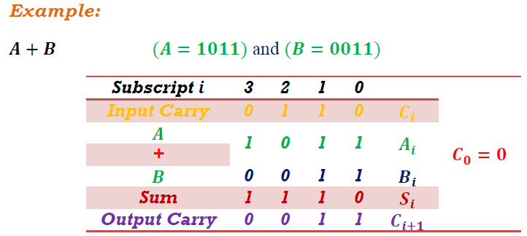
BINARY ADDER

Slide 27
BINARY ADDER
The addition A+B of binary numbers in parallel implies that all the bits of A and B are available for computation at the same time.
As in any combinational circuit, the signal must propagate through the gates before the correct output sum is available.
The output will not be correct unless the signals are given enough time to propagate through the gates connected form the input to the output.
The longest propagation delay time in an adder is the time it takes the carry to propagate through the full adders.

Slide 28
Binary Adder-Subtractor
Subtraction of A – B can be done by taking 2’s complement of B and added to A. The 2’s complement can be done by taking 1’s complement then adding “1” to the result.
And finally the 1’s complement is the binary inversion.

Slide 29
Binary Adder-Subtractor
The addition and subtraction operations can be combined into one common circuit by including Ex-OR with each full adder.
The mode bit M controls the operations.
When M=0 the circuit is adder and when M=1 circuit becomes a subtractor.
Each X-OR gate receives input M and one of the input B.
When M=0, we have B . 0=B the full adders receive the value of B, the input carry 0 and circuit performs A+B.
When M=1 we have B 1=B’ and carry=1. The B input all are complemented a 1 is added through the input carry.
The circuit performs the operation A+2’s complement of B.

Slide 30
Incrementer
The binary incrementer increases the value stored in a register by ‘1’.
For this, it simply adds ‘1’ to the existing value stored in a register.
It is made by cascading ‘n’ half adders for ‘n’ number of bits i.e. the storage capacity of the register to be incremented.
Hence, a 4-bit binary incrementer requires 4 cascaded half adder circuits.

Slide 31
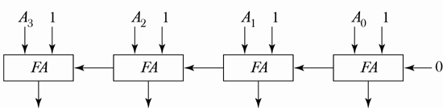
Binary Decrementer
Binary decrementer decrease the register value by 1.
Decrement can be achieved by taking 2’s complement of 1 and adding to A.
A – 1 = A + 2’s complement of 1 = A + 1111

Slide 32
ARITHMETIC CIRCUIT
The arithmetic micro operations listed in table can be implemented in one composite arithmetic circuit.
This circuit comprised of full adders and multiplexers. The multiplexer controls which data is fed into Y input of the adder.
The output of the binary adder is computed from
D = A + Y +Cin
The Y input can have one of 4 different values: B, B’, always “1”, or always “0”.

Slide 33
ARITHMETIC CIRCUIT

Slide 34
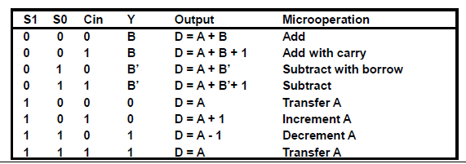
ARITHMETIC CIRCUIT
Arithmetic Microoperations

Slide 35
ARITHMETIC CIRCUIT
Case 1: When S1 S0=0 0
Cin =0 then output D= A+B
Cin = 1 then output D=A+B+1
Both cases perform add micro operation with or without adding input carry.
Case 2: S1 S0 =01 the complement of B is applied to the y inputs of the adder.
If Cin=1 then D= A + B’ +1 =>A - B
Cin = 0 then D= A + B’ => A – B- 1
Case 3: S1 S0= 10 all zero’s are inserted into the y inputs.
If Cin = 0 then the output D= A + 0 + 0 => A
Cin = 1 then the output D= A+1
In a first case we have a direct transfer from input A to output D. in the second case, the value of A is incremented by 1.
Case 1 : When S1 S0 =11 all the one’s are inserted into the Y inputs.
If Cin = 0 then output D= A+ all 1’s
D= A+ ( 2’s Complement of 1)
D= A - 1
Cin= 1 then output D = A- 1- 1 = A
Which causes a direct transfer from input A to output D.

Slide 36
LOGIC MICROOPERATIONS
Logic micro operations specify binary operations on the strings of bits in registers. Logic micro operations are bit-wise operations, i.e., they work on the individual bits of data.
Most systems only implement four of these:
AND ( ), OR ( ), XOR ( ), Complement/NOT

Slide 37
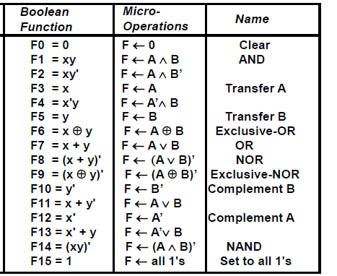
LOGIC MICROOPERATIONS

Slide 38
HARDWARE IMPLEMENTATION OF LOGIC MICROOPERATIONS
Logic Microoperations
A
i
0
B
i
1
4 X 1
F
MUX
i
2
3
Select
S
1
S
0
Function table
S₁ S₀
Output
μ-operation
0 0 F = A ∧ B AND
0 1 F = A ∨ B OR
1 0 F = A ⊕ B XOR
1 1 F = A’ Complement

Slide 39
APPLICATIONS OF LOGIC MICROOPERATIONS
Logic Microoperations
Logic microoperations can be used to manipulate individual bits or a portions of a word in a register
Consider the data in a register A. In another register, B, is bit data that will be used to modify the contents of A
Selective-set A ← A + B
Selective-complement A ← A ⊕ B
Selective-clear A ← A • B’
Mask (Delete) A ← A • B
Clear A ← A ⊕ B
Insert A ← (A • B) + C
Compare A ← A ⊕ B

Slide 40
SELECTIVE SET
Logic Microoperations
The selective-set operation sets to 1 the bits in register A where there are corresponding 1’s in register B.
it does not affect bit positions that have 0’s in B. the following numerical example clarifies this operation:-
1010 A before
1100 B (logic operand)
1110 A after

Slide 41
SELECTIVE COMPLEMENT
Logic Microoperations
The selective-complement operation complements bits in register A where there are corresponding 1’s in register B. it does not affect bit positions that have 0’s in B.
The following numerical example clarifies this operation:-
1010 A before
1100 B (logic operand)
0110 A after

Slide 42
SELECTIVE CLEAR
Logic Microoperations
The selective-clear operation clears to 0 the bits in register A only where there are corresponding 1’s in register B. For example:-
1010 A before
1100 B (logic operand)
0010 A after

Slide 43
MASK OPERATION
Logic Microoperations
The mask operation is similar to the selective-clear operation except that the bits of A are cleared only where there are corresponding 0’s in B. the mask operation is an AND micro operation, for example:-
1010 A before
1100 B (logic operand)
1000 A after masking

Slide 44
CLEAR OPERATION
Logic Microoperations
The clear operation compares the words in A and B and produces an all 0’s result if the two numbers are equal.
This operation is achieved by an exclusive-OR microoperation as has own by the following example:
1010 A
1010 B
0000 A A B
When A and B are equal, the two corresponding bits are either both 0 or both 1. in either case the exclusive-OR operation produces a 0.
The all-0’s result is then checked to determine if the tow numbers were equal.

Slide 45
INSERT OPERATION
Logic Microoperations
The insert operation inserts a new value into a group of bits. This is done by first masking the bits and then Oring them with the required value.
For example, suppose that an A register contains eight bits, 0110 1010. to replace the four leftmost bits by the value 1001 we first the four unwanted bits:-
0110 1010 A before
0000 1111 B (mask)
0000 1010 A after masking
and then insert the new value:-
0000 1010 A before
1001 0000 B (insert)
1001 1010 A after insertion
The mask operation is an AND microoperation and the insert operation is an OR microoperation.

Slide 46
Shift Microoperations
Shift Microoperations are used for serial transfer of data.
They are also used for conjunction with arithmetic, logic and other data-processing operations.
Shift operations can be done on registers.
The content of registers can be shifted to the left or to the right.
A logical shift is one that transfers 0 through the serial inputs.

Slide 47
Shift Microoperations
In shift left operation the serial input transfers a bit Contents of register into the right most position.
In shift right operation the serial input transfers a bit Contents of register into the left most position.
Shift Microoperations
Symbolic | Descriptive
R = shl R | Shift-left logical register R
R = shr R | Shift-right logical register R
R = cil R | Circular shift-left register R
R = cir R | Circular shift-right register R
R = ashl R | Shift-left arithmetic register R
R = ashr R | Shift-right arithmetic register R

Slide 48
Shift Microoperations
Shift Microoperations
Symbolic | Descriptive
R = shl R | Shift-left logical register R
R = shr R | Shift-right logical register R
R = cil R | Circular shift-left register R
R = cir R | Circular shift-right register R
R = ashl R | Shift-left arithmetic register R
R = ashr R | Shift-right arithmetic register R
Shift left
High order
Bit Loss
Low Order
Input 0
Shift right
High order
Input 0
Low Order
Bit Loss

Slide 49
Shift Microoperations
In circular shift circulate the bit of register around the two ends without loss of information.
Shift Microoperations
Symbolic | Descriptive
R = shl R | Shift-left logical register R
R = shr R | Shift-right logical register R
R = cil R | Circular shift-left register R
R = cir R | Circular shift-right register R
R = ashl R | Shift-left arithmetic register R
R = ashr R | Shift-right arithmetic register R
Circular shift left
High order
to Low order
Low order
from High order
Circular shift right
High order
From Low order
Low order
to High order

Slide 50
Shift Microoperations
An arithmetic shift is a microoperation that shifts a signed binary number to the left or right.
An arithmetic shift left multiplies a signed number by 2.
An arithmetic shift right divides a signed number by 2.
Shift Microoperations
Symbolic | Descriptive
R = shl R | Shift-left logical register R
R = shr R | Shift-right logical register R
R = cil R | Circular shift-left register R
R = cir R | Circular shift-right register R
R = ashl R | Shift-left arithmetic register R
R = ashr R | Shift-right arithmetic register R
Arithmetic shift left
High order
Bit Loss
Low Order
Input 0
Arithmetic shift right
High order
Input High order
Low order
Bit Loss

Slide 51
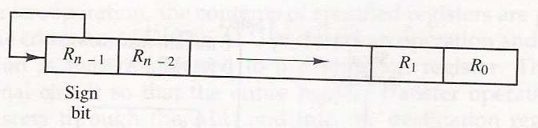
Shift Microoperations
The arithmetic shift right leaves the sign bit unchanged and shift the number(including the sign bit) to the right.
The Rn-1 remains the same, Rn-2 receives the bit from Rn-1 and so on for the other bits of the register. The bit in R0 is lost.
The arithmetic shift-left inserts a 0 in R0, and shift all other bits to the left.
The initial bit Rn-1 is lost and replace by Rn-2. A sign reversal occurs if the bit in Rn-1 changes in value after the shift.

Slide 52
Shift Microoperations
If the bits Rn-1 and Rn-2 are not same then overflow will occur.
An overflow flip-flop V_{s} can be used to detect an arithmetic shift-left overflow
V_{s} = R_{n-1} ⊕ R_{n-2}
R_{n-1}
1 → overflow
0 → no overflow
V_{s}=
R_{n-2}

Slide 53
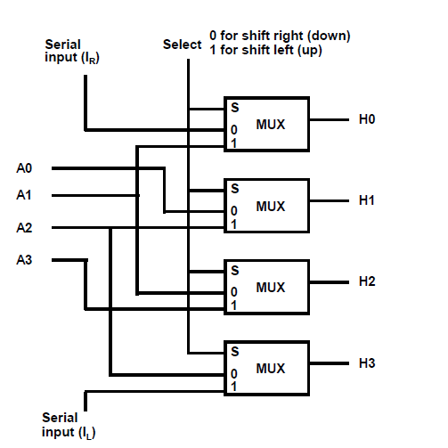
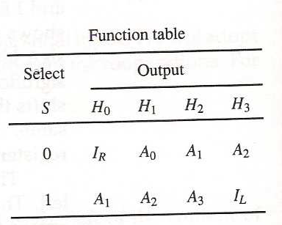
Hardware Implementation of logic microoperations

Slide 54
Arithmetic Logic Shift Unit
Instead of having individual registers performing the microoperations directly, computer systems employ a number of storage registers connected to a common operational unit called an Arithmetic Logic Unit (ALU)

Slide 55
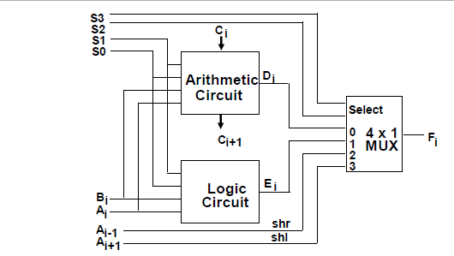
Arithmetic Logic Shift Unit

Slide 56
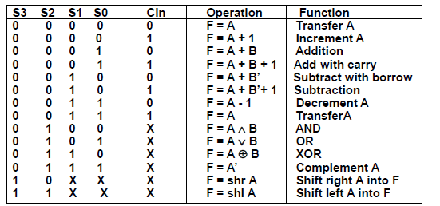
Arithmetic Logic Shift Unit

